Slide 1

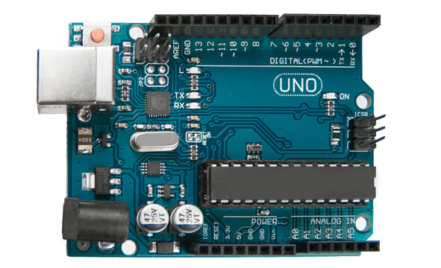

Cost-Effective IOT Framework for Enterprise Monitoring and Alerting
Spark Tank 2025 proposal

Slide 2
Overview
Problem
Solution
Future capabilities
Requested resources
Conclusion

Slide 3

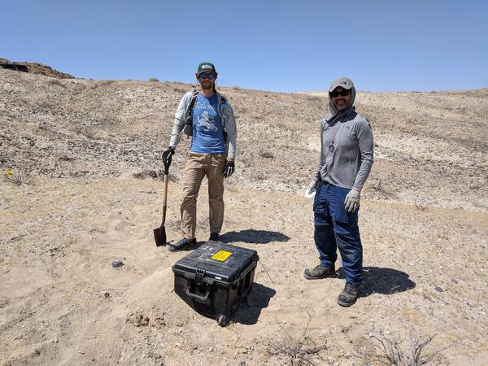
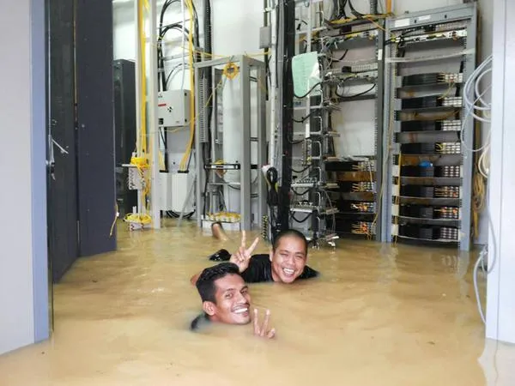
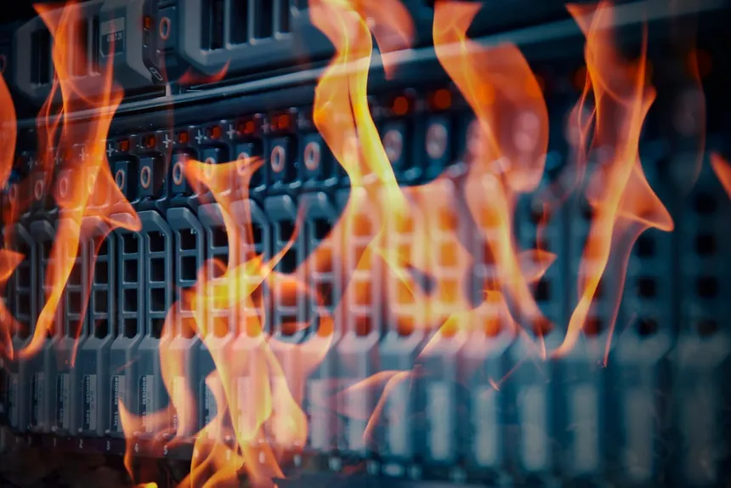
Problem: Unable to detect and respond to events
Events
Power loss
Overheating
Humidity/ flooding
Research sensing (seismic, sound, machine signals)

Slide 4



Problem: Old technology cannot meet need
Old technology problems
Relies on grid power to operate
Relies on ground networks to operate (power disruptions impact)
Expensive with lengthy contract timelines
Operated at base level: end units cannot customize
Cannot accomplish remote sensing

Slide 5


Impact: Downtime, manpower, expensive equipment risk
Downtime: awaiting systems to be brought back up
Manpower: monthly 24-Hour shifts to monitor buildings
Equipment risk: expensive servers, physical security monitors, custom lab equipment

Slide 6

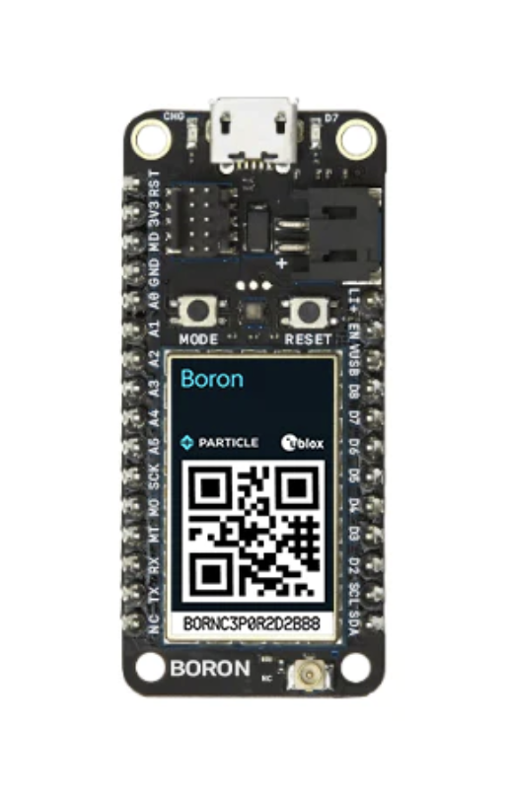
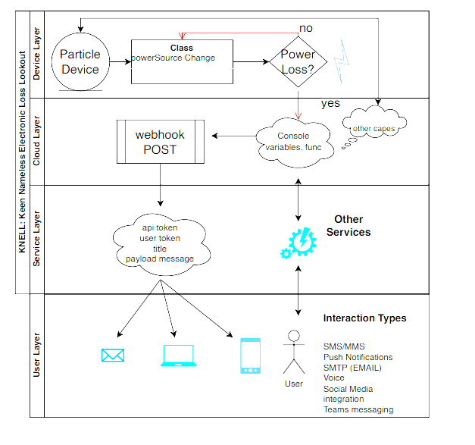
Solution: Device capable of cellular comm for monitoring
Internet Of Things (IOT) devices are cheap
Can leverage low-bandwidth cellular data paths off commercial network
Customized programming & sensors
Can integrate with cloud environments (AWS, Google cloud)

Slide 7




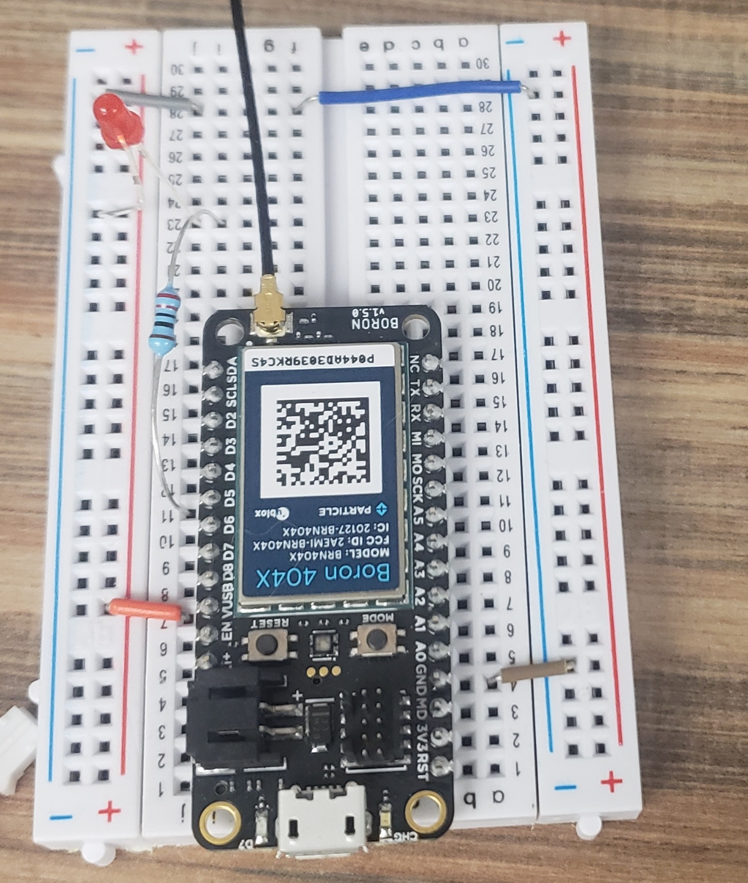
Process:

Slide 8

Solution: Generic, scalable, and easy to use
Text alerts to users whenever power loss occurs
New users added via mobile app, deploy new devices where needed
Can update code over the air from cloud backend
Custom sensors to meet user needs

Slide 9
Solution Impact: GOTS product enables future capabilities
Solutions can be extended for harder problems: GNSS, NTN
END POINT data collection for machine learning
END POINT AI / Computer Vision
Notes:
Mention that solution is already MVP/ prototyped

Slide 10



The Ask:
3-4 technical engineers assigned to help realize the product
~$2-4K for hardware design
~$1-2K for cloud resources

Slide 11
Conclusion
Problem
Solution
Future capabilities
Requested resources
Conclusion

